Slide 1
CSS (CONT..)

Slide 2
Pseudo Selector
A pseudo-class is used to define a special state of an element.
For example, it can be used to:
Style an element when a user mouses over it
Style visited and unvisited links differently
Style an element when it gets focus

Slide 3
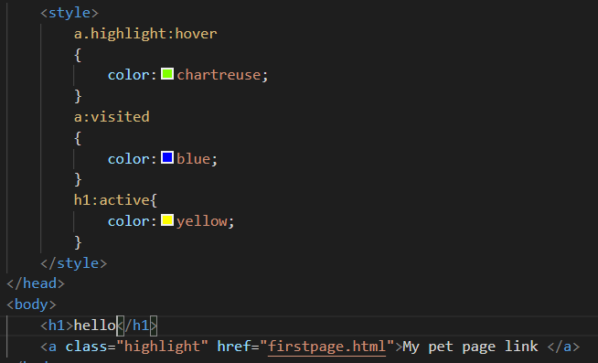

Slide 4
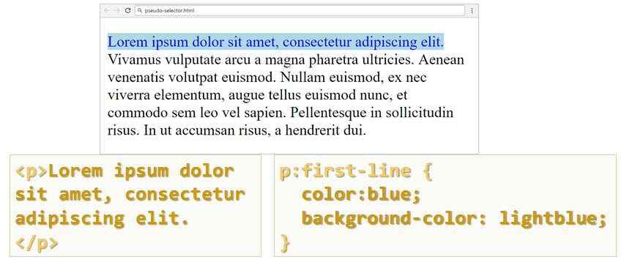

Slide 5
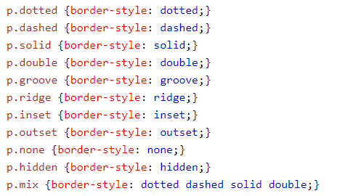
Border Style
The border-style property specifies what kind of border to display.

Slide 6
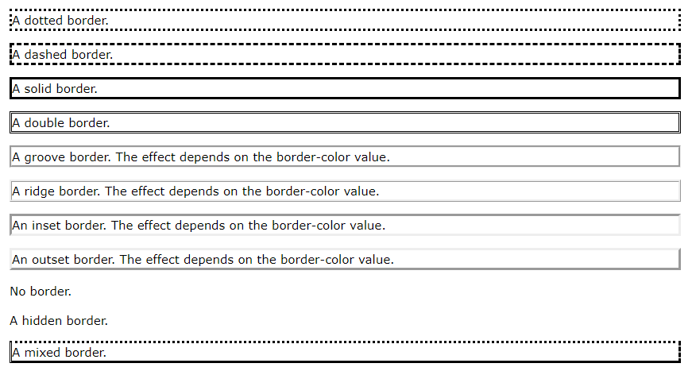

Slide 7
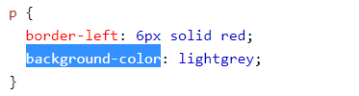

border-width
border-color
background-color

Slide 8
<div> and <span>
Block-level Elements
<div> tag - A block-level element always starts on a new line and takes up the full width available (stretches out to the left and right as far as it can).
Inline Elements
<span> tag - An inline element does not start on a new line and only takes up as much width as necessary.

Slide 9
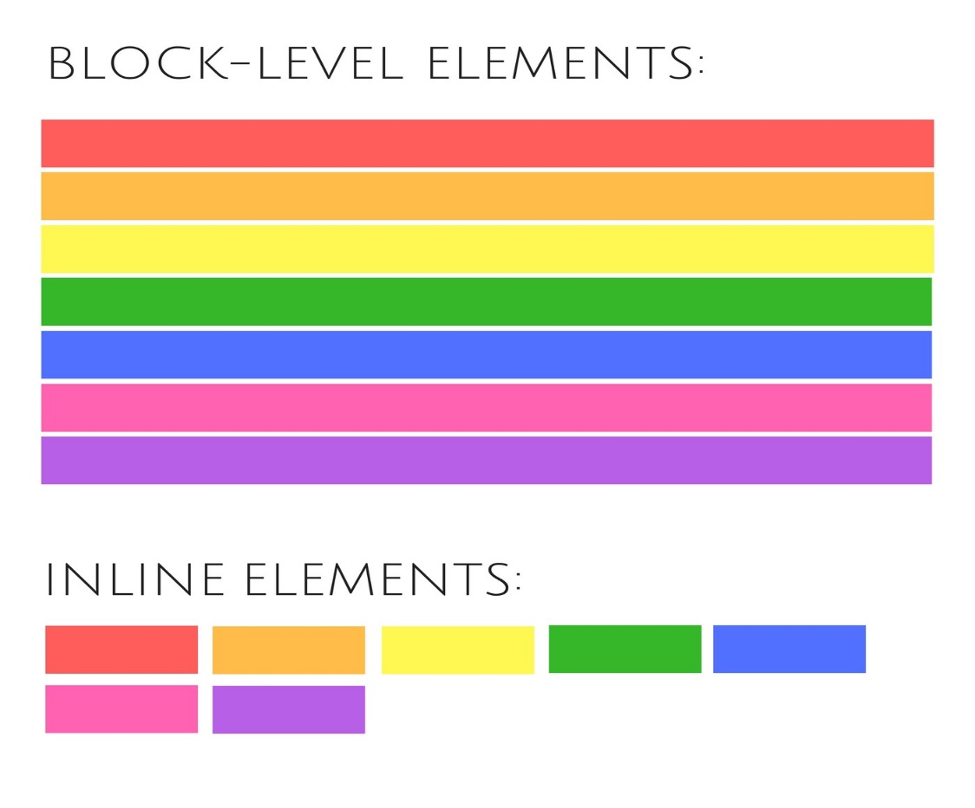
Block level and Inline elements

Slide 10
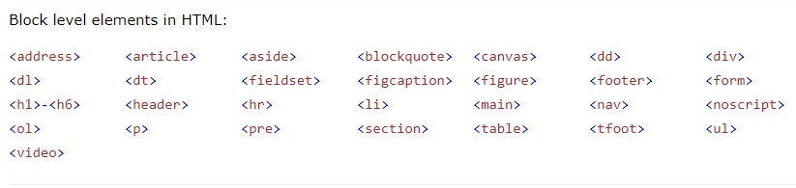
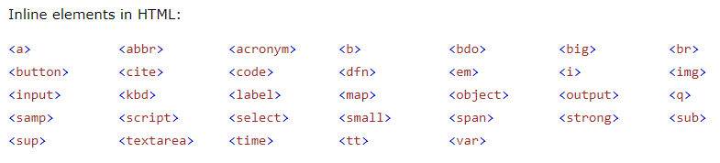

Slide 11
CSS Margin and Padding
Padding - The CSS padding properties are used to generate space around an element's content, inside of any defined borders.
margin: 25px 50px;
top and bottom margins are 25px
right and left margins are 50px

Slide 12
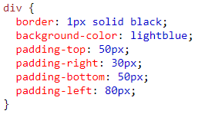
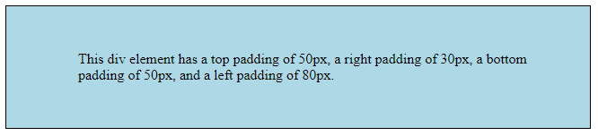

Slide 13
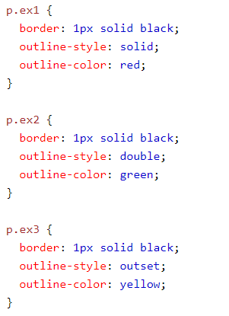
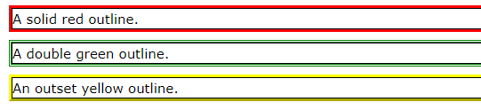
Outline
The outline-style property specifies the style of the outline.
The outline-color property is used to set the color of the outline.

Slide 14
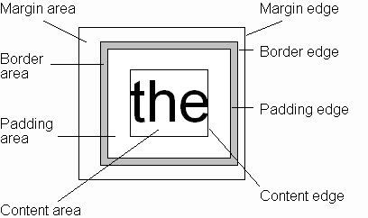
CSS Box Model

Slide 15
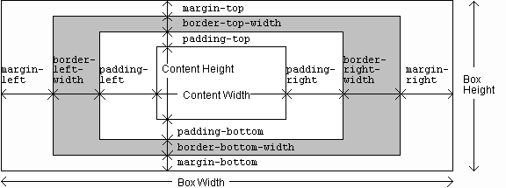
CSS Box Model

